Slide 1


AFL STATISTICAL ANAYSIS

Slide 2
HAS AFL SCORING BEEN ON A DOWNWARD OR UPWARD TREND IN THE LAST TWO DECADES?
Using available Data from AFL Tables.com I have used Yearly Data from 2000 to 2021 with the exclusion of 2020 to see the Average Final Scores of AFL Matches
2020 Has been excluded from the research as the year was affected by COVID -19 and in result had less games and shortened quarter lengths

Slide 3
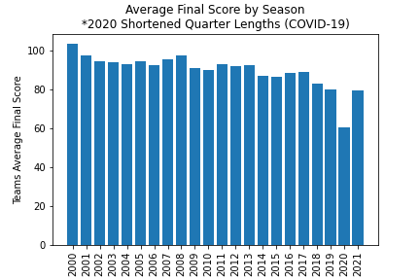
This Graph shows us that since the Year 2000 Scoring in the AFL has been on a steady Decline
Why would this matter for the AFL? The AFL wants a higher scoring game for greater fan engagement and to produce a better product for entertainment purposes and TV.

Slide 4
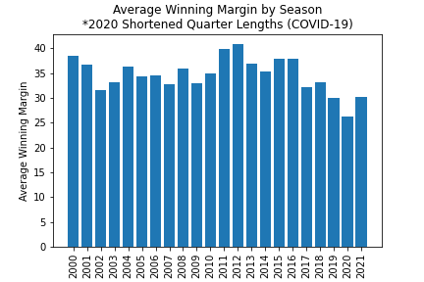
After seeing that Total Game score has been on a steady decrease has this affect the final winning margins?
Would we expect a similar decrease in average winning margins with the total score decreasing yearly. However as shown by this graph the pattern is not as consistent as the decrease in scores

Slide 5
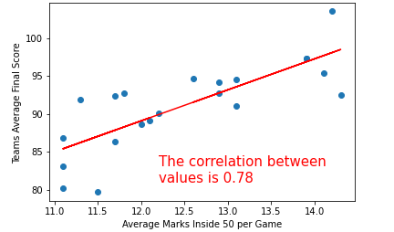
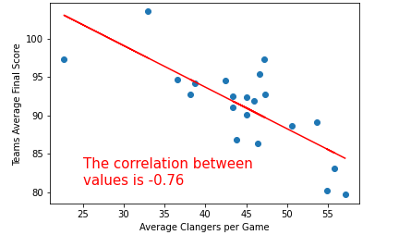
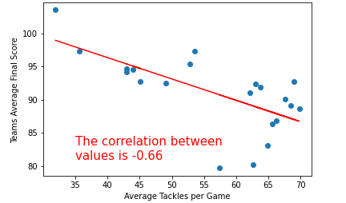
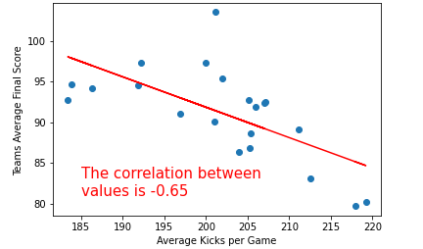
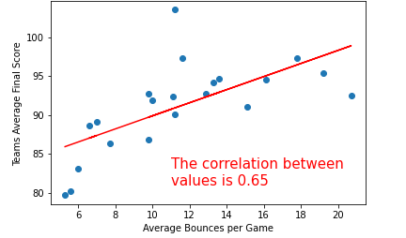
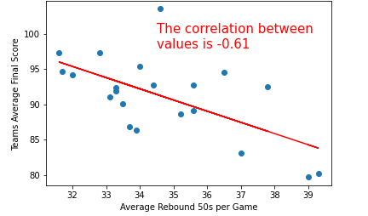
Correlation >0.6 or -0.6 between Average Scoring and Average Stat Categories per AFL Game
Marks Inside 50
Clangers
Tackles
Kicks
Running Bounces
Rebound 50s

Slide 6
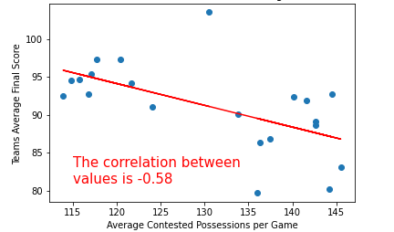
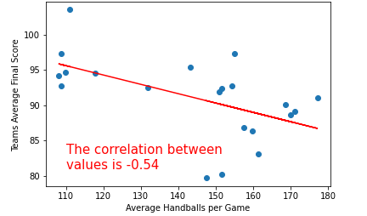
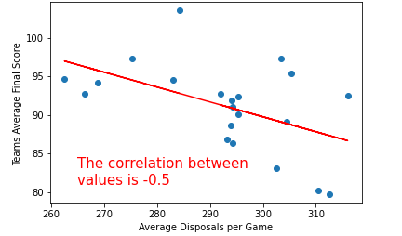
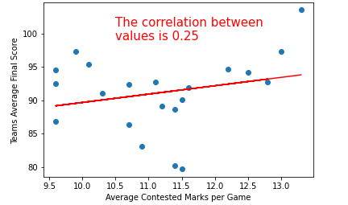
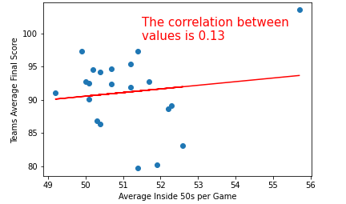
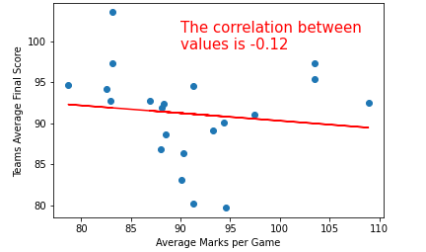
Correlation <0.6 or -0.6 between Average Scoring and Average Stat Categories per AFL Game
Contested Possessions
Handballs
Disposals
Contested Marks
Entries Inside 50
Overall Marks

Slide 7
WHAT DOES THIS DATA SAY ABOUT WHY THE SCORING HAS BEEN ON A DECLINE?
Marks Inside 50
Marks inside 50 have heavily decreased since 2000
This stat is a key statistic to why scores has have been trending down
This is because it is a guaranteed scoring shot at goal

Slide 8
WHAT DOES THIS DATA SAY ABOUT WHY THE SCORING HAS BEEN ON A DECLINE
Tackles and Clangers have increased but are highly correlated to lower scoring
Running Bounces have heavily decreased and less bounces are correlated to lower scoring
Kicks, Contested Possessions and Rebound 50s are up which is correlated to lower scoring
Inside 50 Entries and Marks seem to have no correlation to lower scoring

Slide 9
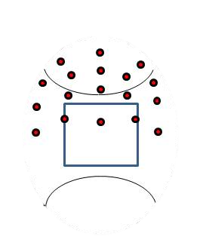
CONCLUSION
The tactics of the game have changed over the last two decades with an emphasis on guarding and closing down space around the ground and defensive 50. As seen by less Marks Inside 50 and less running bounces
More Pressure around Contests in the back half has seen tackles increase and in turn Clangers have increased.
All these factors have resulted in lower overall scoring trends

